Slide 1

GREEN TECHNOLOGY

Slide 2


1 COST
The positive impact of Green IT on the bottom line of the business is part of what organizational leadership is trying to achieve.
A good sustainable approach by an organization includes opportunities to optimize its processes, consolidate its technologies, and thereby reduce its costs.
costs provide an excellent driver for the organization to
come up with a comprehensive Green IT strategy.

Slide 3
EXAMPLES OF COST REDUCTION
Include reduction in the use of raw materials and equipment, recycling of equipment, and optimization of storage.
While effort to reduce costs can provide motivation for reduction in carbon emissions.
Another example is, optimizing a business process can eliminate the need for a desktop machine but, instead, there may be a need to replace that desktop with a mobile device.
At the organizational level, costs associated with the green enterprise transformation program need to be factored in along with the anticipated reduction in costs due to the transformation.

Slide 4
2 REGULATORY
Regulatory acts such as NGERs (National Greenhouse and Energy Reporting) and CPRs (Carbon Pollution Reduction) require organizations to mandatorily report their carbon emissions once they reach a certain level.
Regulatory bodies also provide some basic calculators (e.g., OSCAR) to enable calculations of greenhouse gases.
That calculators are used to arrive at the total carbon emissions of the organization that can be used to decide whether the organization falls under a mandatory reporting requirement.

Slide 5
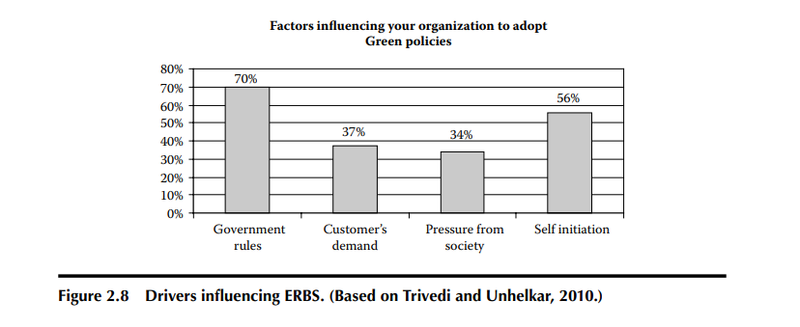
This figure indicates that the government rules and regulations are a major driver for many green enterprise transformation programs.
A relative importance given to this regulatory factor, as compared with the other factors such as organization self-initiation, customers demand, and the pressure from society are the highest.
Regulatory acts such as NGERs (National Greenhouse and Energy Reporting) and CPRs (Carbon Pollution
Reduction) require organizations to mandatorily report their carbon emissions once they reach a certain level.
Regulatory bodies also provide some basic calculators (e.g., OSCAR) to enable calculations of greenhouse gases. That calculators are used to arrive at the total carbon emissions of the organization that can be used to decide whether the organization falls under a mandatory reporting requirement.

Slide 6
In addition to the basic calculators, green information systems also source external regulatory data (such as permissible emission figures), store, analyze, and broadcast the results that enable monitoring and improvement of performance of the organization. That organizational specific green information systems need to be much more sophisticated than the basic calculators provided by the regulatory bodies (Unhelkar and Philipson, 2009).
An example of such mandatory reporting requirements is the Australian government regulation. On October 31, 2009, approximately 1000 Australian businesses fell under the mandatory reporting requirements for the carbon emitters above 150kT per annum (National Greenhouse and Energy Reporting Act, 2007).
Another example is of the American Clean Energy and Security Act that was passed to reduce emissions by 17% in year 2020 (compared with 2005 levels) and around 80% by 2050 (this legislation is yet to reach a vote in the Senate). That also has a mandatory target of a 20% reduction in greenhouse gases by 2020 (compared with 1990) ---- with particular emphasis on the cap-and-trade EU Emissions Trading Scheme (EU ETS), that covers major emitters of CO2.
Finally, the UK government has also passed legislation in November 2008 that aims to achieve emissions reduction of at least 26% by 2020 and 80% by 2050, against a 1990 baseline.

Slide 7

3 LEGAL
Environmental legislations put together by governing bodies have a greater enforcing power than the aforementioned social opinions.
For example, in Australia, it is now legally binding for an organization emitting more than 150 KT (kilo tone) of carbon to calculate and report it to the government on an annual basis.
Regulatory and legal requirements now make it mandatory for organizations to comply with carbon emission requirements.
Formation of a comprehensive environmentally responsible strategy is then undertaken to ensure that the organization is compliant with the legal requirements.

Slide 8
Legislative requirement is a major driver for vending organizations to revamp their architectures and designs that would enable easier recycling and reduce the issues associated with electronic waste that is generated at the end of the life of a equipment rather than the carbon generated during its operation.
Appropriateness and application of the legal, compliance requirements relating to the environment will change depending on the industry.
Eventually, legislative changes can drive markets and influence the strategic directions of organization.
For example, as mentioned in the EU discussion earlier, legislative demands require vending organizations to restructure their offerings.

Slide 9
Legislation changes the bar for competition and requires creation of new business streams and business formats.
Another example is the incoming legislations allowing trading of carbon on the stock exchange that will result in significant changes in t he business models of organizations a s the value of the organization will depend on its carbon credits.
On the manufacturing front, carbon tariff and carbon related tax breaks would change the way, say, cars or toasters are produced. Even operationally, in the coming few years, one would expect a gauge next to the mileage odometer, showing the total carbon emitted by that auto; and legislations that would be binding to the way that vehicle is manufactured and operated.

Slide 10

THANK YOU

